Slide 1
NVMe Basic Training Nvme Spec: 1.2.1
Xiaofei Yang
02/12/2018

Slide 2
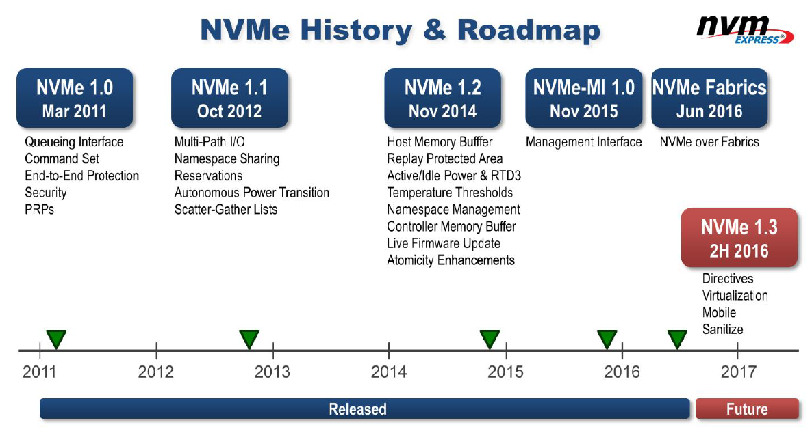
Introduction
NVMe is an optimized, high-performance scalable host controller interface utilize PCI Express based solid-state storage.
During development, NVMe was referred to as Enterprise NVMHCI
Form factors:
M.2
U.2 SFF-8639
Add-in PCIe card (AIC)

Slide 3
NVMHCI vs AHCI
 | AHCI | NVMe
Maximum queue depth | One command queue; 32 command per queue | 65535 queues; 65536 command per queue
Uncacheable register accesses | Six per non-queued command; nine per queued command | Two per command
MSI-X and interrupt steering | A single interrupt; | 2048 MSI-X interrupts
Parallelism and multiple threads | Requires synchronization lock to issue a command | No locking
Efficiency for 4 KB commands | Command parameters require two serialized host DRAM fetches | Gets command parameters in one 64-byte fetch

Slide 4
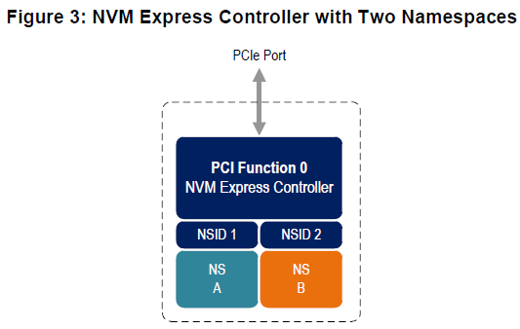
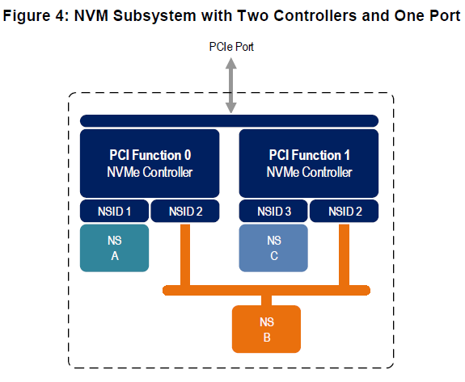
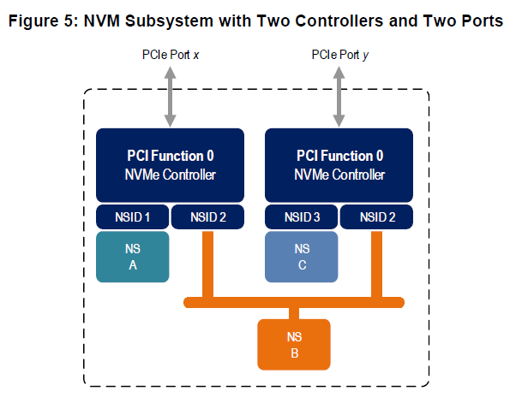
NVMe Concept – Controller & Namespace
An NVM Express controller is associated with a single PCI Function.
A namespace is a quantity of non-volatile memory that may be formatted into logical blocks.
Multi-Path I/O and Namespace Sharing -the ability for two or more hosts to access a common shared namespace using different NVM Express controllers

Slide 5
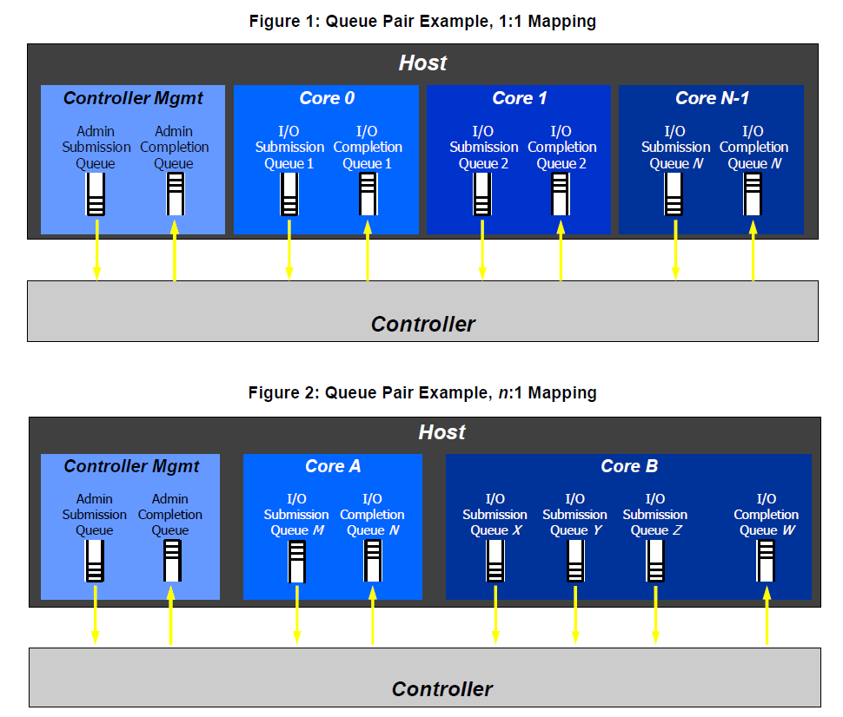
NVMe Concept – Queue
Submission Queue – the queue to submit commands for execution by the controller.
Completion Queue – the queue to indicate command completions .
Admin Queue – the Submission Queue and Completion Queue with identifier 0.
Multiple Submission Queues may utilize the same Completion Queue
It is not possible to delete the Admin Submission Queue

Slide 6
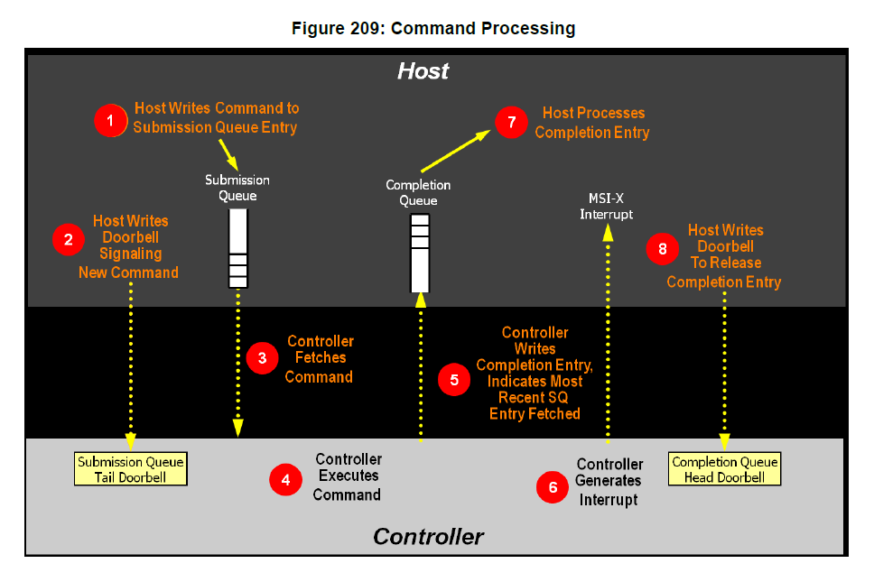
NVMe Concept – Queue & Cmd Execution
Doorbell – the register for triggering the cmd to be executed.

Slide 7
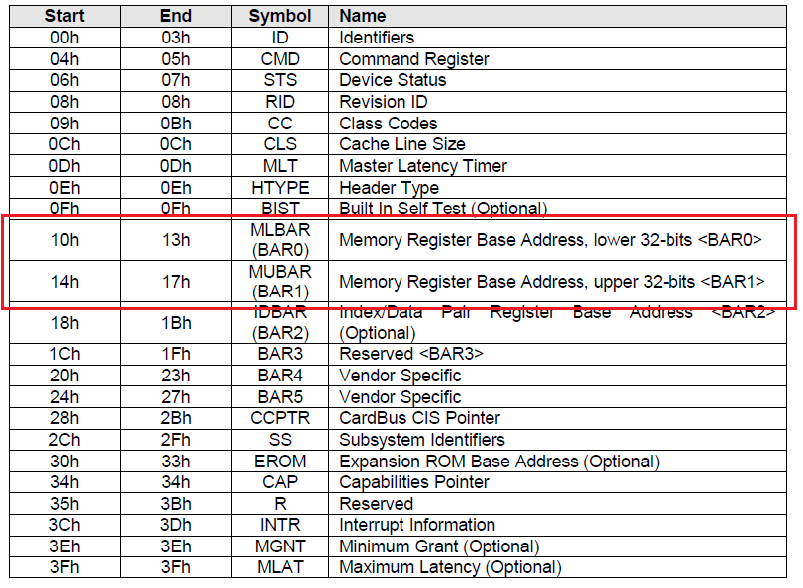
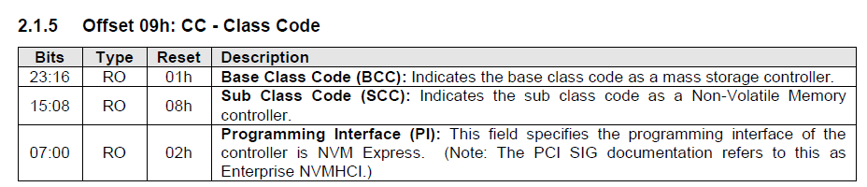
Structure overview – PCIe Header
BCC=01: Mass storage controller
SCC=08: Non-Volatile memory controller
PI =02: NVM Express

Slide 8
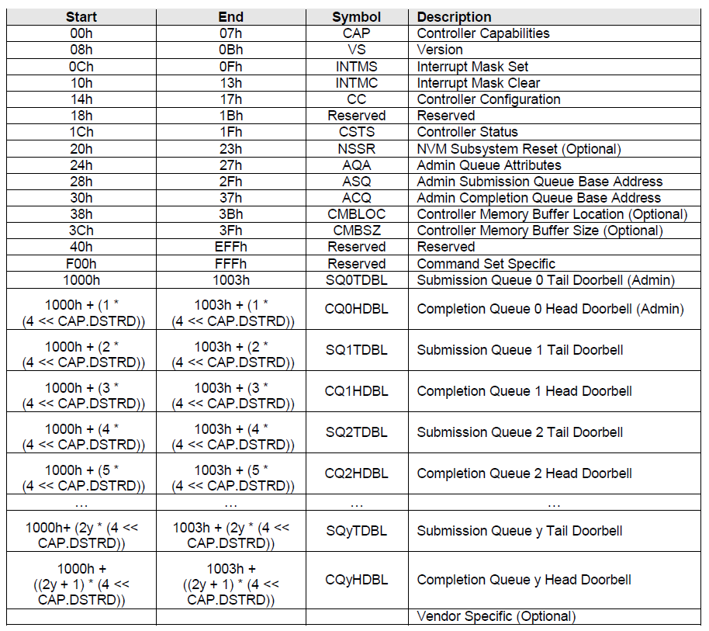
Structure overview – Controller Register

Slide 9
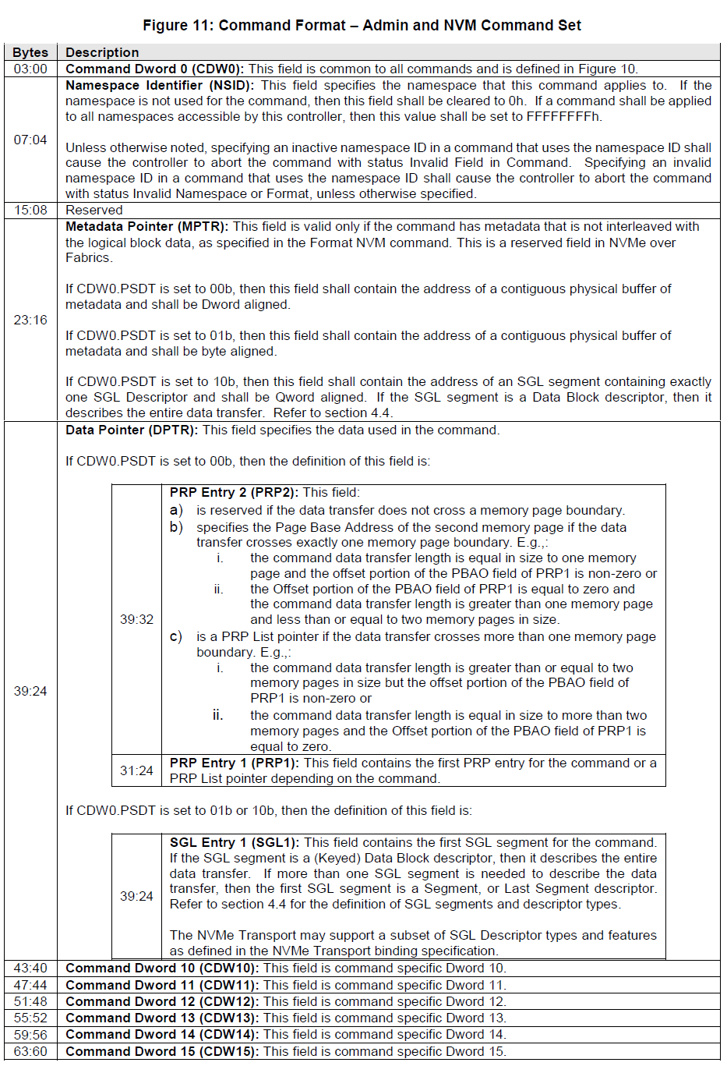
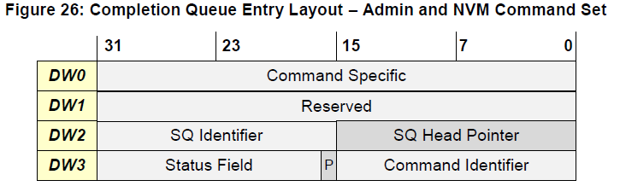
Structure overview – Command

Slide 10



